Slide 1
Dr. Lingli Ni and Maryam Farsian

Slide 2
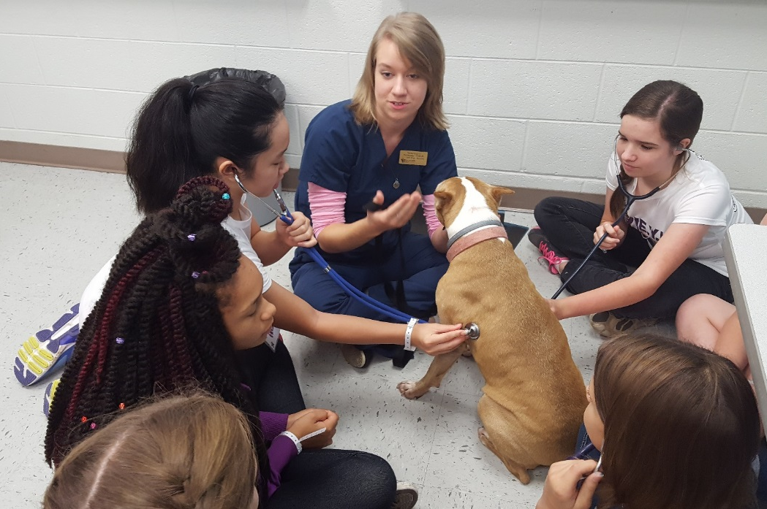
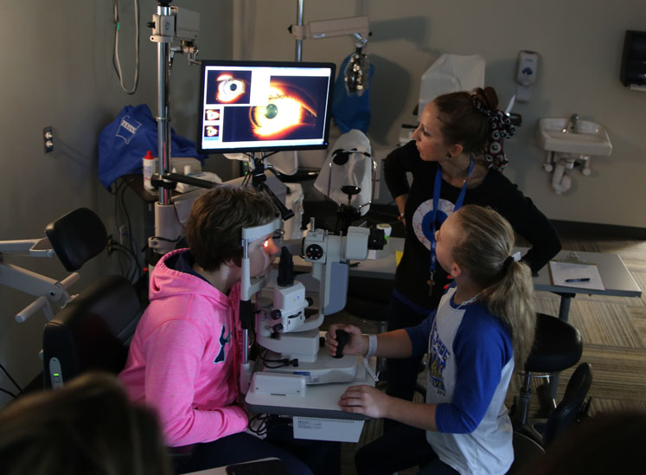
Goals of EYH
Allow young women to investigate STEM careers
Small group interactions and hands-on activities
Engaging girls with female STEM role models
Meet other young ladies interested in STEM
Promote STEM fields as possible career choices

Slide 3
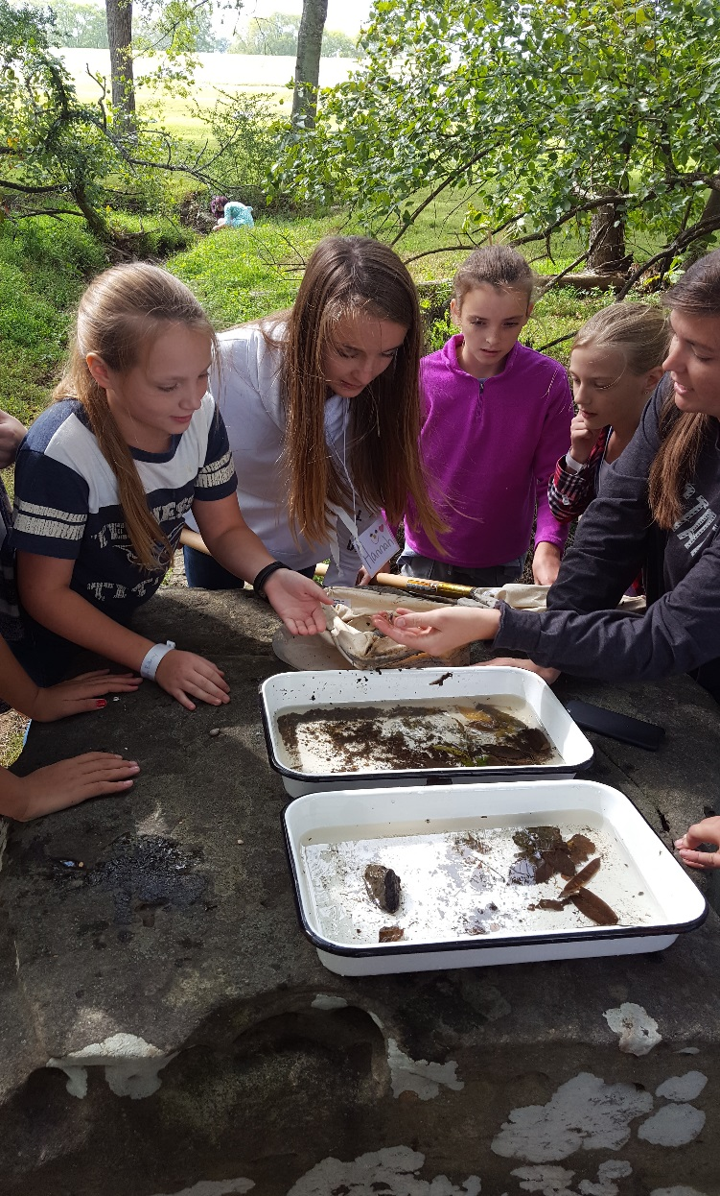
Get Hands-on and Interactive!
Two typical layouts
Rotate through stations (10-15 mins each)
One activity with more than one phase
Work in groups of 2-4, encourage teamwork
Use pencil and paper, equipment, computers, smart phones, etc.
Answer a problem or question
Role play
Do a simulation
Play a game
Evaluate a product, design, etc.

Slide 4
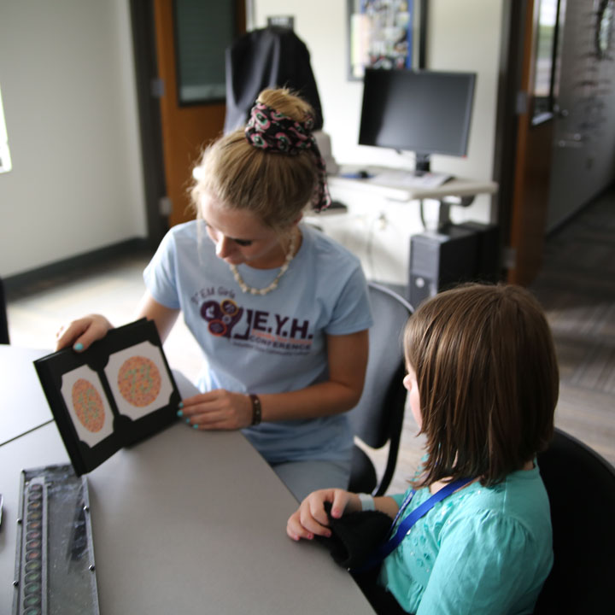
Workshop Details
5 Minutes - Script
5 Minutes - Teach your workshop
25 - 30 Minutes - Hands on activity
10 Minutes - Questions? Clean up and prepare for next workshop
Before you begin your workshop: * Meet the “group leaders" escorting each group of girls *Ask them to keep you on schedule by providing a sign when you have 5 minutes or so left in your session.

Slide 5
Questions to Expect
Describe a typical day on your job.
How did you pick this career?
What is your life away from work life?
Have you experienced any challenges?
What were the most useful subjects you took in school?
What other jobs could you do with your experience and training?
What is your salary? What is the range of salaries for people in this career?

Slide 6
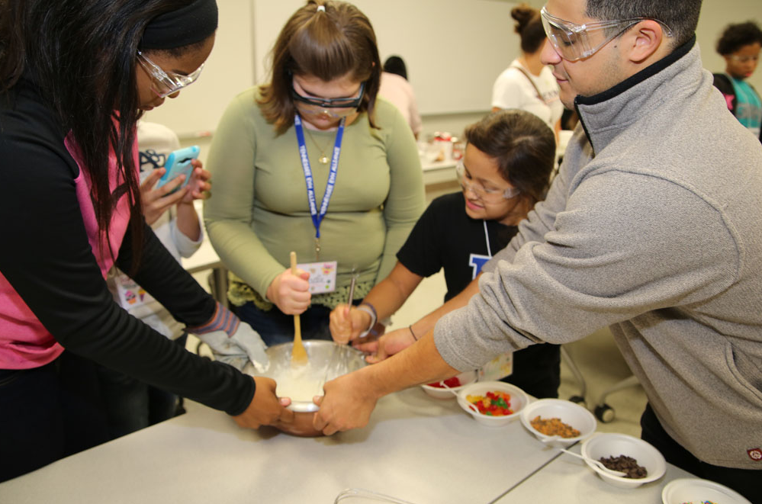
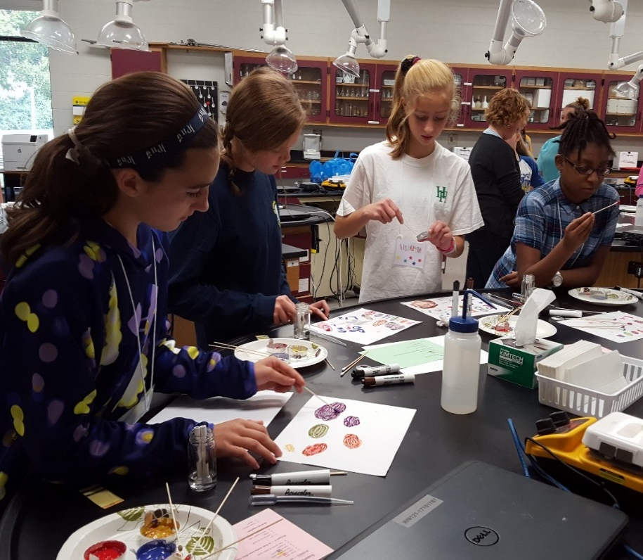
Tips for Workshop Leaders
Practice and have enough materials for each girl/group
Use examples that are relevant to their lives
Try to reduce anxiety among the girls and build confidence
Ask open-ended questions - Don’t give them the answers right away
Give positive feedback, encouragement, validation, etc.

Slide 7
2017 General Feedback

Slide 9
2017 Feedback
EYH was a Big Success!
Learned alot!
Interested in topic, found new interests
Easy to understand
Everyone was helpful
Got to use equipment, computers, etc.
Opened my eyes to more STEM fields
Helped me focus
Hands-on, games, many activities, one on one interactions, detailed
Loved solving puzzles/played a game/got to test things

Slide 10
2017 Feedback
The girls loved the workshops!
Cool to see your own eyes and how each eye is different
Learned how animals see color
TBH it was Lit!!
Loved how to build a circuit and turn on light
We got to blow the fuse!
Got to go outside and catch animals, like being in water. Taught well, learned about animals and pollution.
We learned about DNA and investigated a crime.
Got to make bugs/build our own model
Got to do procedures in EMT and meet Bernie
Learned about cells and diseases, cool reactions

Slide 11
2017 Feedback
Suggestions for EYH Conference
Less talking, more activities
More hands on
More stations per workshop
Relate it to real world
All ages might not understand
List of things needed (sunscreen, shoes, etc.)
Girls need map, schedule

Slide 12
2017 Feedback
General Conference Feedback
Fun, Amazing, You did a GREAT job!
This was a big opportunity for me!
Actually made me want to learn and listen
Best class I have ever taken!
I want to go to college here
On Monday I’m going to be an A+ student!
100% kid approved
THANK YOU so much!

Slide 13
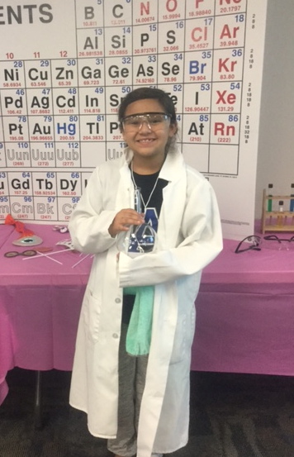
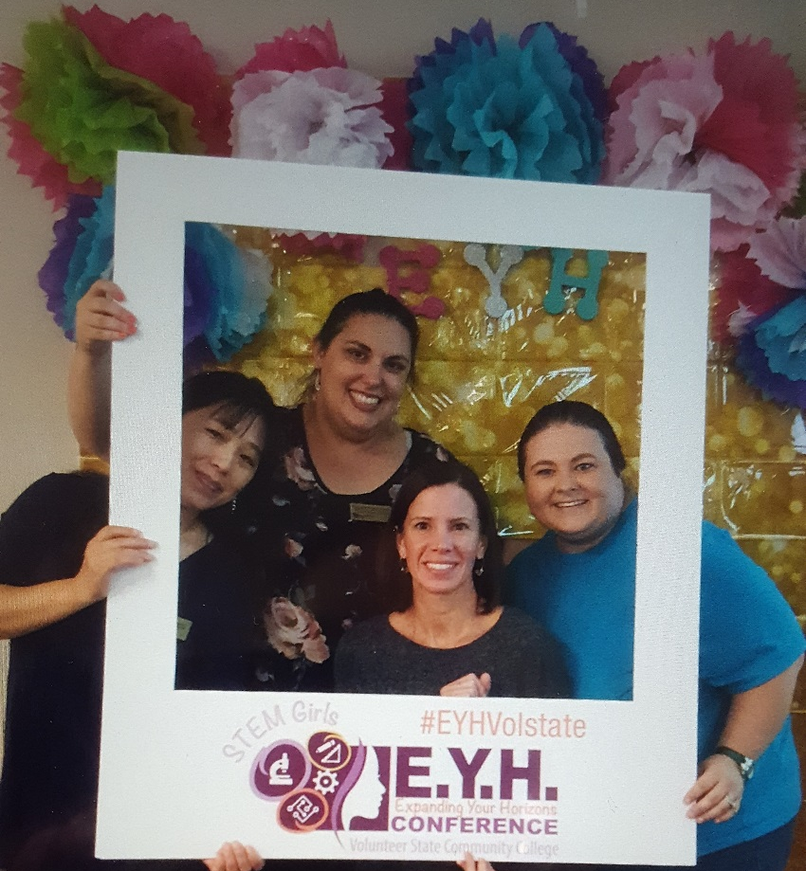
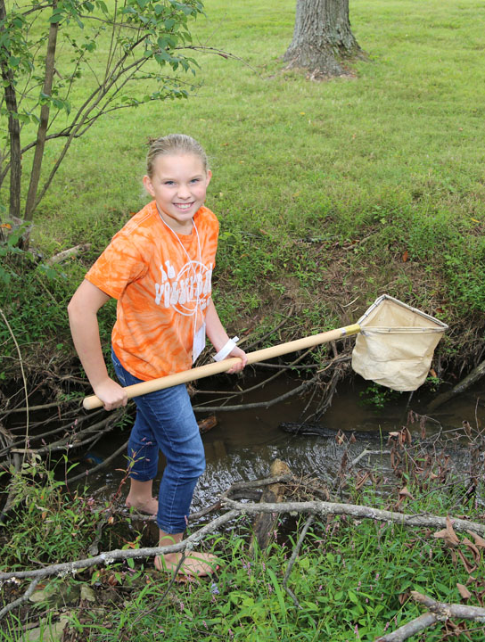
THANK YOU to everyone for participating!

